Slide 1
Cleft Lip and palate
Dr Nitin Sharma MBBS( Gold Medalist), MS, MCh(Gold Medalist), FMAS, FISPU AIIMS, New Delhi Assistant Professor(Pediatric Surgery)

Slide 2
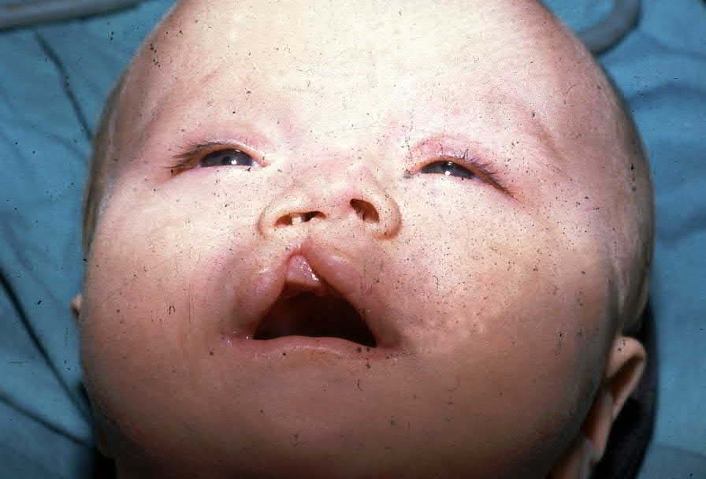
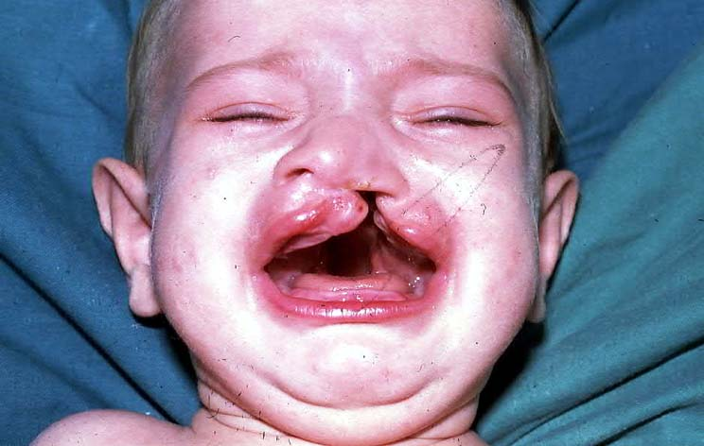
PRESENTATIONS
Is it possible to be normal with treatment?

Slide 3
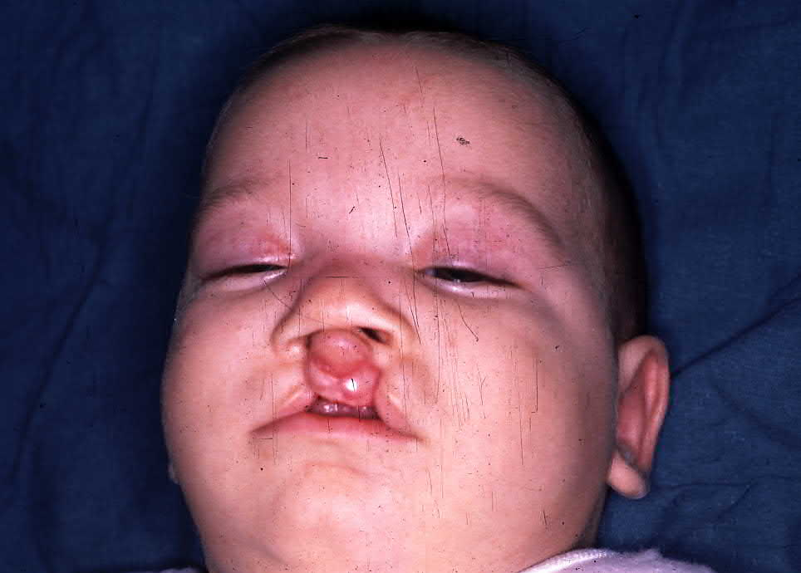
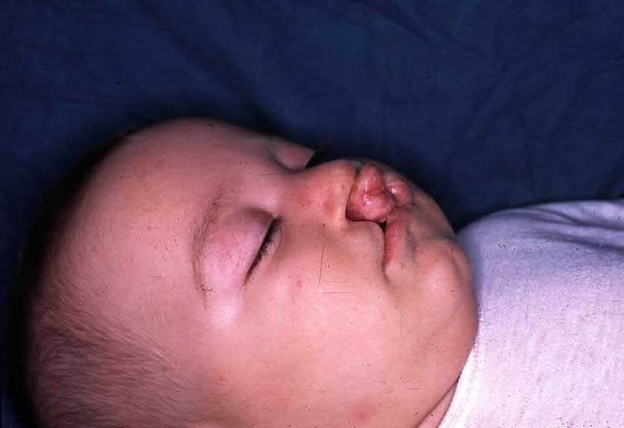
PRESENTATIONS
Why did happened, Who has fault?
How should I feed my baby?

Slide 4
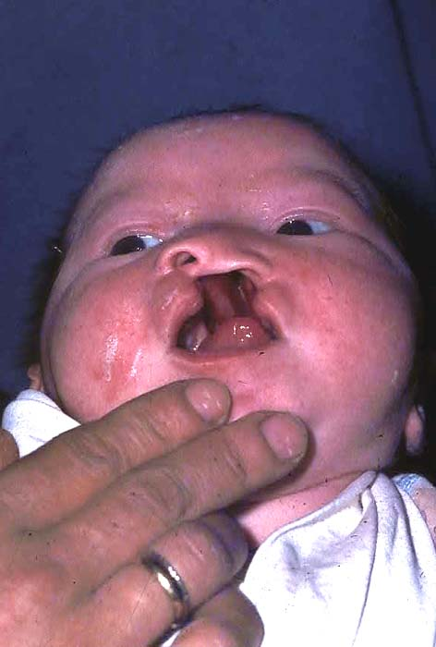
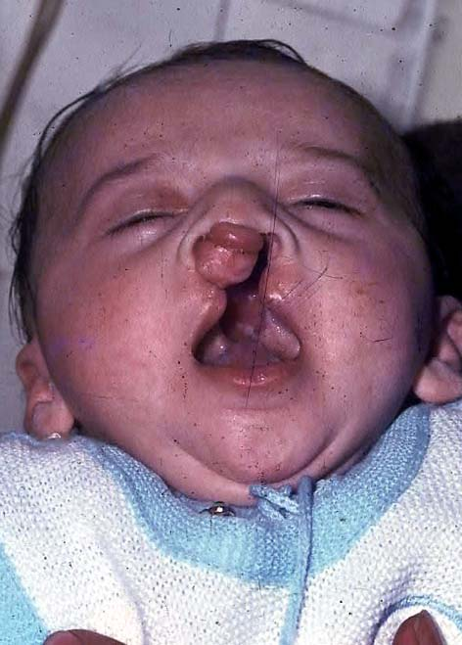
FUTURE ???

Slide 5
CLASSIFICATION SYSTEMS DAVIS AND RITCHIE CLASSIFICATION(1922):
Group I – Pre alveolar clefts:
Unilateral cleft lip
Bilateral cleft lip
Median cleft lip
Group II - Post alveolar clefts:
Cleft hard palate alone
Cleft soft palate alone
Cleft soft palate and hard palate
Sub mucous cleft

Slide 6
CLASSIFICATION SYSTEMS DAVIS AND RITCHIE CLASSIFICATION(1922):
Group III-Alveolar clefts:
Unilateral alveolar cleft
Bilateral alveolar cleft
Median alveolar cleft

Slide 7
VEAU CLASSIFICATION (1931)
Group I (A) - Defects of the soft palate only
Group II (B) - Defects involving the hard palate and soft palate extending not further than the incisive foramen, thus involving the secondary palate alone.
Group III (C) – Complete unilateral cleft, extending from the soft palate to the alveolus, usually involving the lip
Group IV (D) - Complete bilateral clefts, resembles Group III but is bilateral. When cleft is bilateral, pre-maxilla is suspended from the nasal septum.

Slide 8
ARTURO SANTIAGO CLASSIFICATION:
Santiago A proposed a classification in 1969
He used four digits to indicate presence of cleft and its location.
Each digit is followed by letter to indicate condition of cleft (complete, incomplete or sub mucous)
Four digits represent the following four structures affected by cleft.
The first digit refers to the lip.
The second digit refers to the alveolus.
The third digit refers to the hard palate.
The fourth digit refers to the soft palate.

Slide 9
ARTURO SANTIAGO CLASSIFICATION:
The numbers used as digits represents the condition of cleft
0= No cleft
1= Midline cleft
2= Cleft on right side
3= Cleft on left side
4= Bilateral cleft
The letters indicate more specifically the type of cleft
A = An incomplete midline cleft
B = An incomplete cleft of right side
C = An incomplete cleft of left side
D = Bilateral incomplete cleft
E = Sub mucous cleft

Slide 10
LAHSAL CLASSIFICATION OF CLEFT LIP AND PALATE:
Kreins O (cited by Hodgkinson et al) proposed LAHSHAL system for classification of cleft lip and palate patients which was modified on the recommendation of Royal College of Surgeons Britain in 2005

Slide 11
LAHSAL CLASSIFICATION OF CLEFT LIP AND PALATE:

Slide 12
ELNASSRY CLASSIFICATION:
Elnassry proposed following classification in 2007. He divided cleft lip and palate patients in to seven classes.
Class I: Unilateral cleft lip
Class II: Unilateral cleft lip and alveolus
Class III: Bilateral cleft lip and alveolus
Class IV: Unilateral complete cleft lip and palate
Class V: Bilateral complete cleft lip and palate
Class VI: Cleft hard palate
Class VII: Bifid uvula

Slide 13
Embryology
Primary Palate Forms during 4th to 7th week of Gestation
Defect anterior to incisive foramen
prepalatal alveol, maksilla, lip, nose and palatine bone
Unilateral or bilateral
Cleft severity varies
Complet ( all skin, muscle, mucosa, maksillary and nasal bones, nasal cartilages)
Incomplet (intact nasal sill, minimally seperated, only small scar)
Secondary Palate Forms in 6th to 9th weeks of gestation
Palatal shelves change from vertical to horizontal position and fuse
Tongue must migrate antero-inferiorly
Face is formed at intrauterin at 10th week

Slide 14
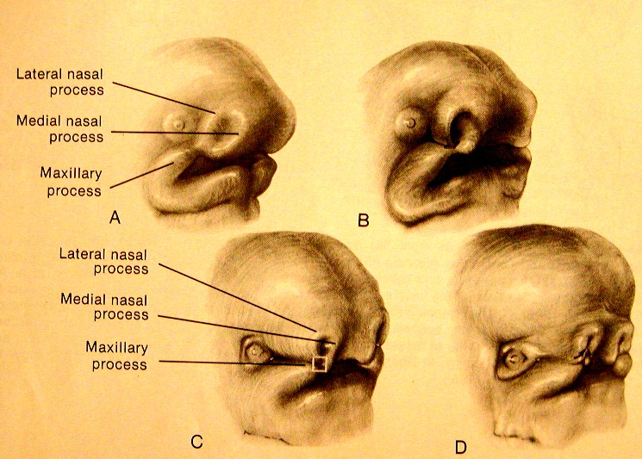

Slide 15
Palate Devolopment
Primary palate median palatine processes premaxilla
Secondary palate lateral palatine processes

Slide 16
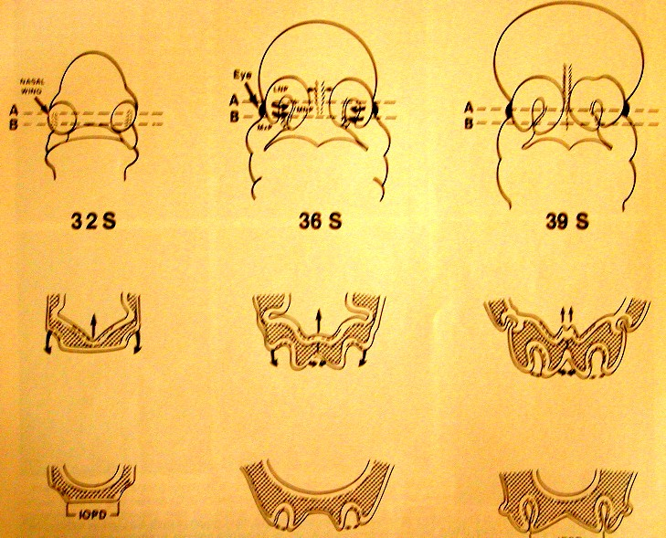
Palate Devolepment(6-12. Weeks)

Slide 17
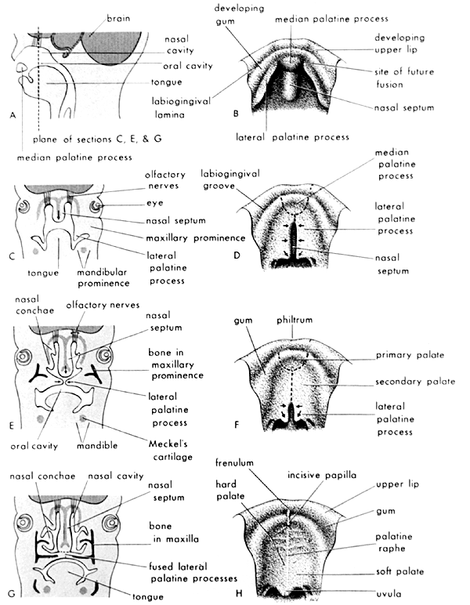
Palate Devolopment (6-12. Weeks)

Slide 18
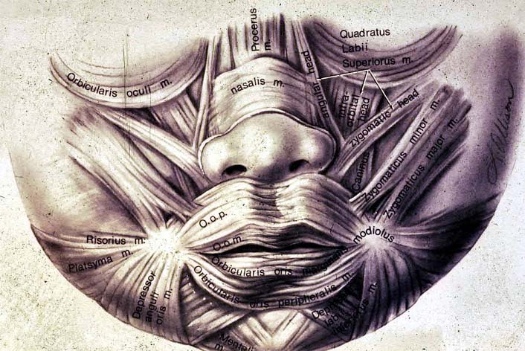
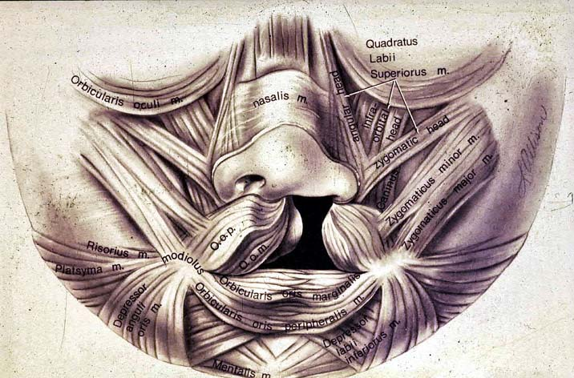
NORMAL LIP MUSCULAR ANATOMY
CLEFT LIP ANATOMY

Slide 19
Problems in Cleft Lip and Cleft Palate
Feeding
Frequent upper respiratuary tract infection
Frequent gas regurgitation
Otitis media
Nasal regurgitation of food
Aspiration pneumenia
Growing retardation
Other anomalies
Psycological problems (family)

Slide 20
Feeding Rules
Swallowing is not impaired, oral feeding is possible
Feeding with a spoon/palade.
The child should be held in a head-up position at about 45 º during and after feeding
Lateral position during sleeping

Slide 21
When to Operate
Generally (Rules of 10’s)
Weight > 10 pound (4500 gr)
Hb > 10 gr
Age > 10 weeks
Cleft lips between 3-6 months
Cleft palate between 12-18 months (preferred before speech devolops)

Slide 22
Cleft Lip Treatment
Cleft lip
Mikroform cleft lip
Unilateral cleft lip
Bilateral cleft lip
Associated nasal deformity is classified as mild, moderate or severe
Alveolar arc position evaluated. If necessary “presurgical maksiller orthodontics” applied

Slide 23
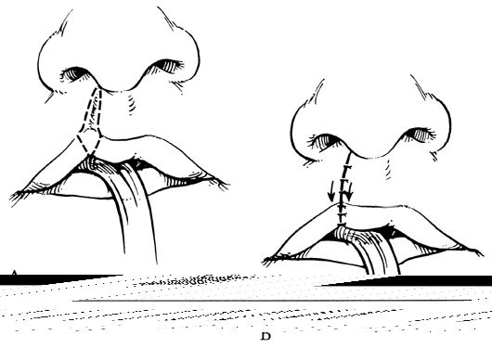
Operation technique in Microform cleft (Straight line closure)

Slide 24
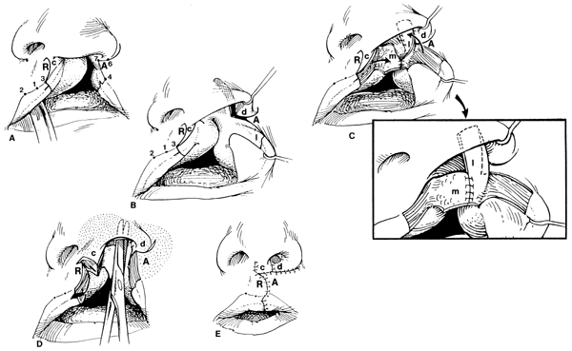
Surgical technique for unilateral cleft lip
(Millard Rotation-Advancement)

Slide 25
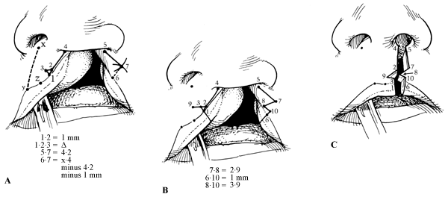
Surgical technique for unilateral cleft lip
(Tennison Triangular Flap)

Slide 26
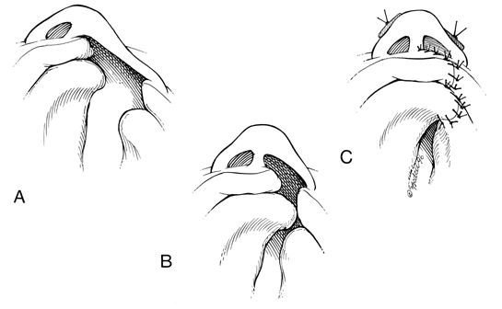
Surgical technique for unilateral cleft lip and palate
Millard techniques provides primary lip and nasal repair . It is possible “gingivoperiostoplasy” after “Presurgical maksiller ortopedics”

Slide 27
Pre -Orthodontic treatment
After 3 months of Grayson molding plate application

Slide 28
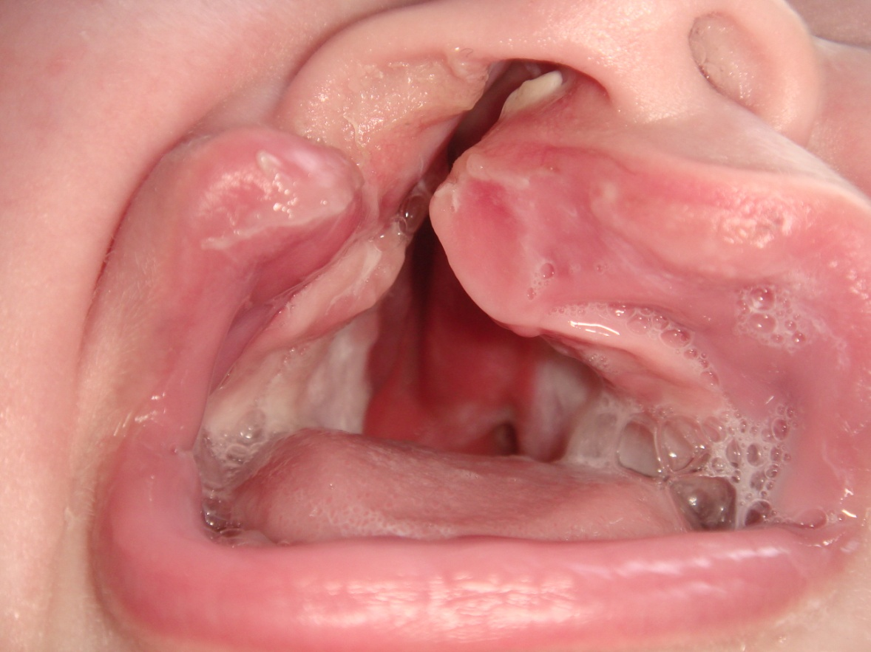
A.M.Kul, right unilateral primary and secondary cleft palate
Pre -Orthodontic therapy
After 3 months of Grayson molding plate application

Slide 29
Postoperative 6 months

Slide 30
Postoperative 1,5 years

Slide 31
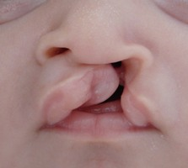
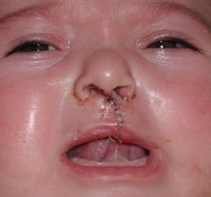
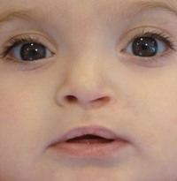

Slide 32
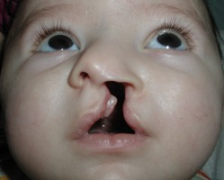
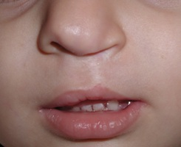

Slide 33
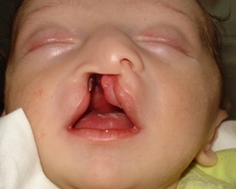
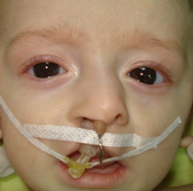
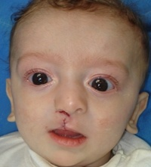
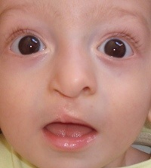

Slide 34
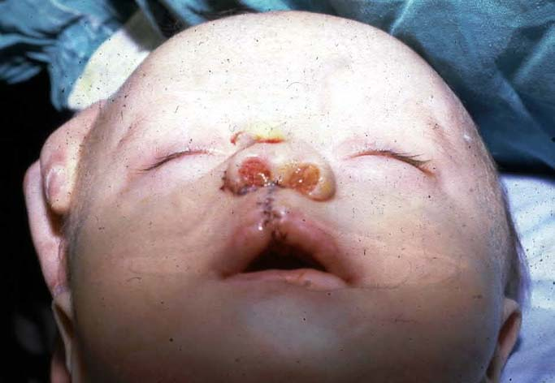

Slide 35
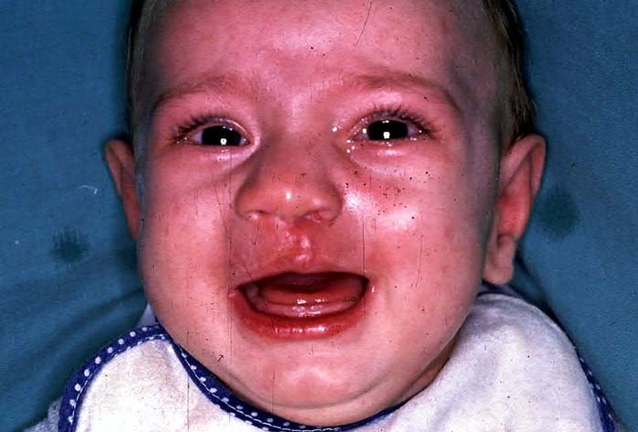

Slide 36
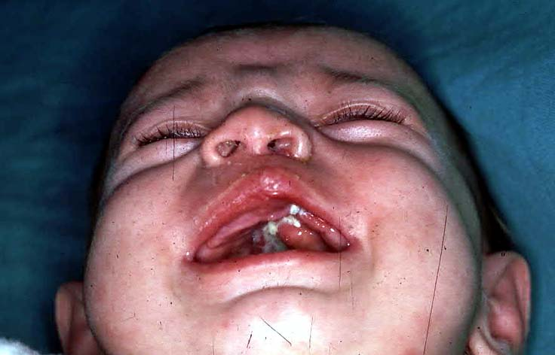

Slide 37
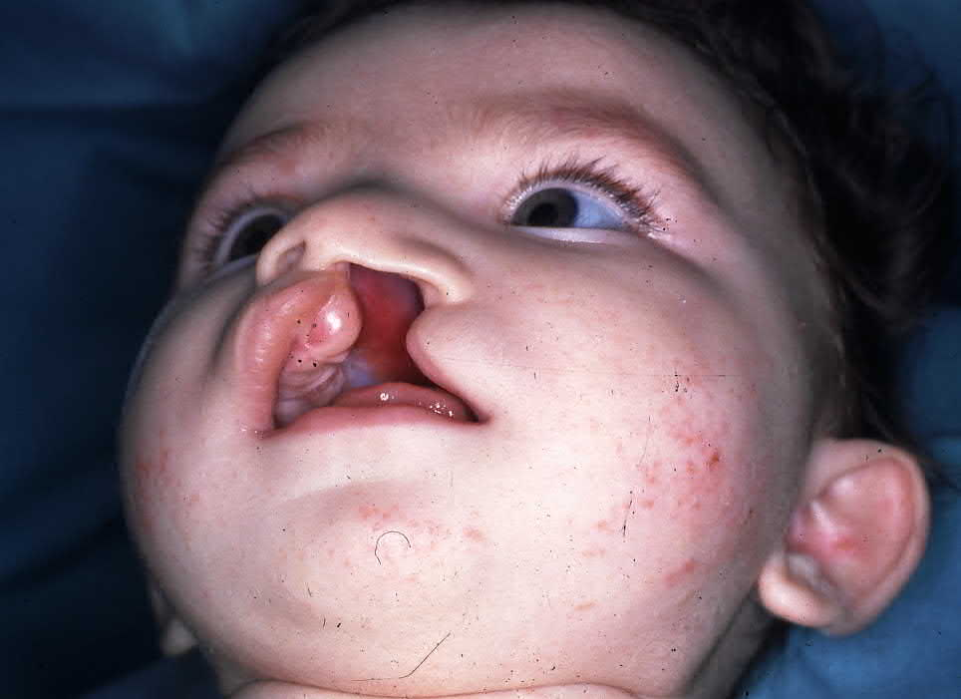
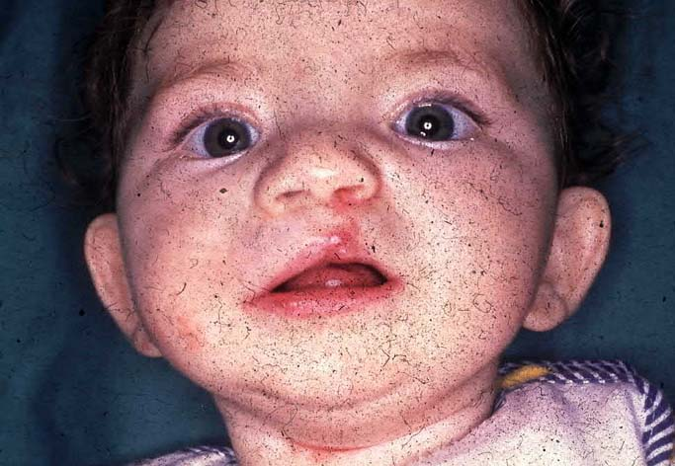

Slide 38
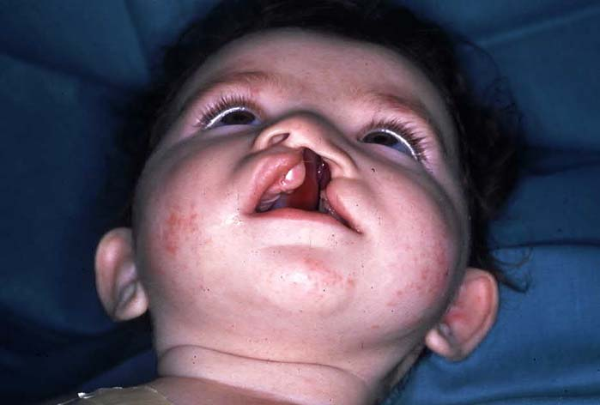
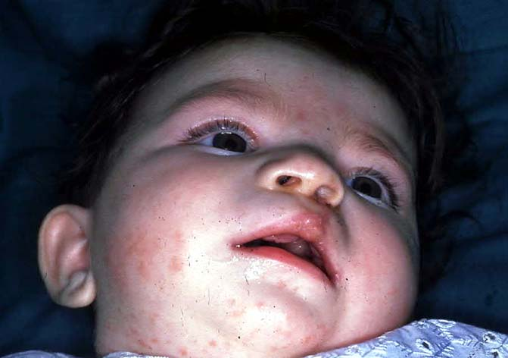

Slide 39
Bilateral Cleft Lip
More complex and difficult to treat
Projectile premaxilla
Broad and flared nasal tip
Prolabium
Short columella or absent columella
Incomplete or complete
It is important to retropositon the premaxilla with presurgical orthopedic treatment
Surgical techniques used for unilateral cleft lip repair are used for bilateral cleft lip repair in one or two stage operation (Millard, Tennison...)

Slide 40
Treatment of Premaxilla
Lip repair or “Lip-adhesion”
Elastic traction ( with a Head Bonnett)
Premaxillary retantion (Latham)
Nasoalveoler molding (Grayson)
Surgical premaxilla excision or set-back (severe maxillary retrusion)

Slide 41
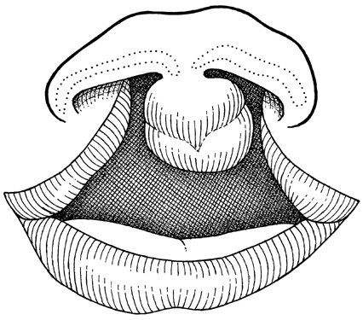
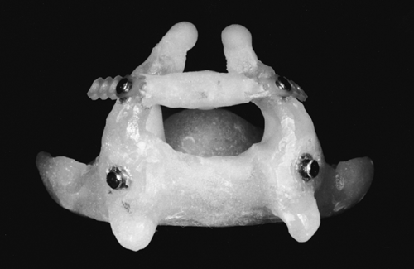
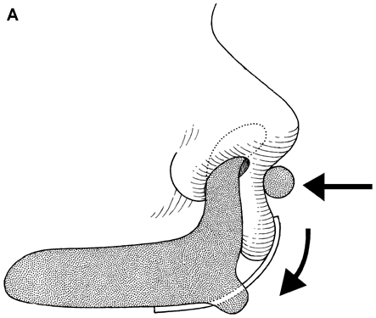
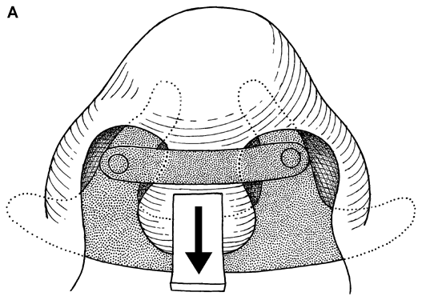

Slide 42
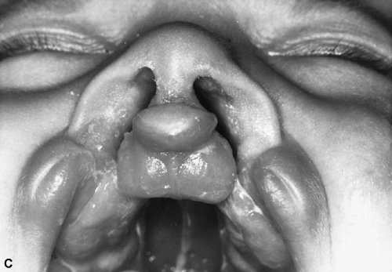
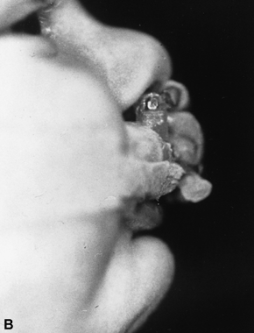
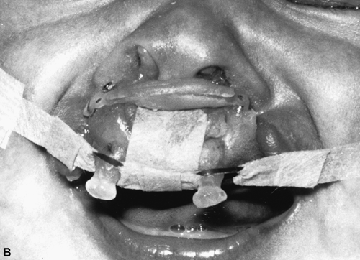

Slide 43
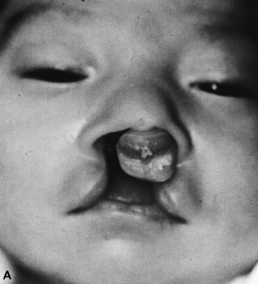
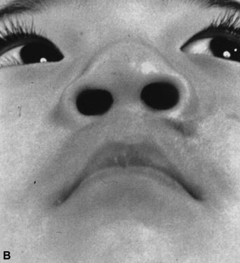

Slide 44
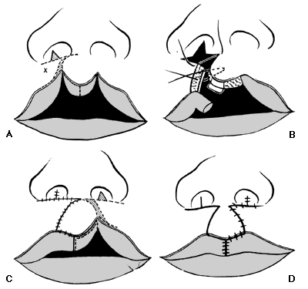
Bilateral Incomplete Cleft lip Operation Technique
Millard (Two stage)

Slide 45
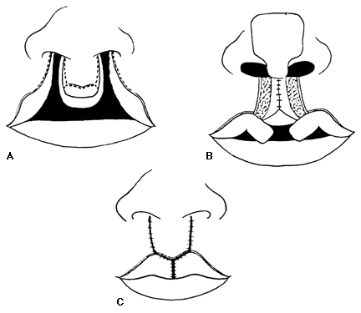
Bilateral Incomplet Cleft lip Operation Technique
Straight Line Closure (One stage)

Slide 46
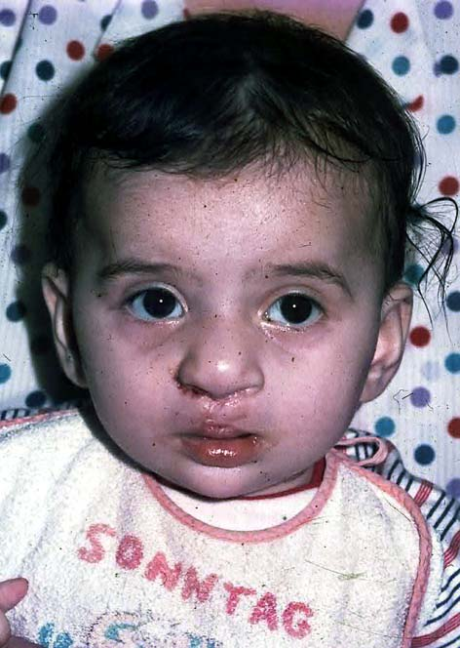

Slide 47
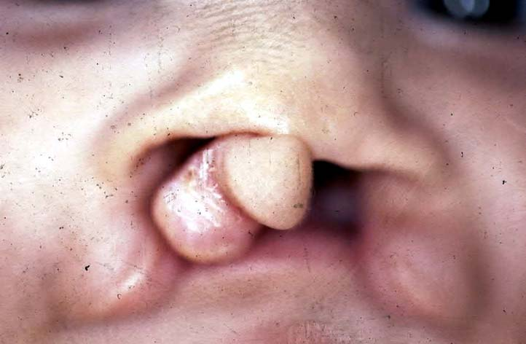
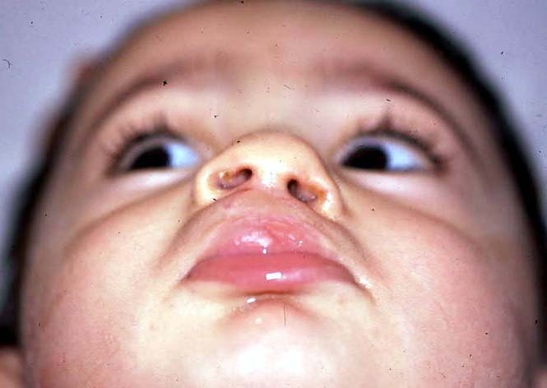

Slide 48
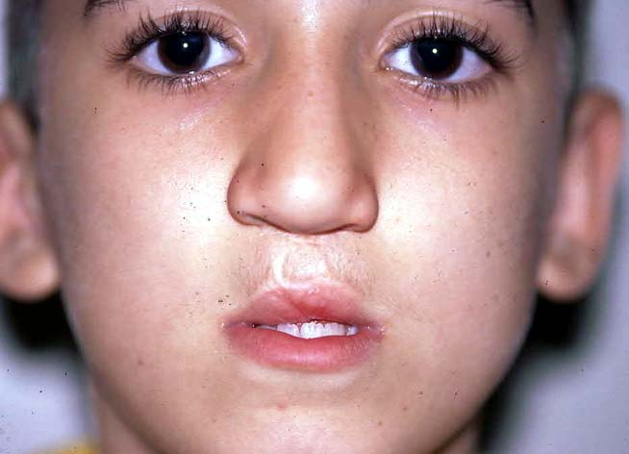
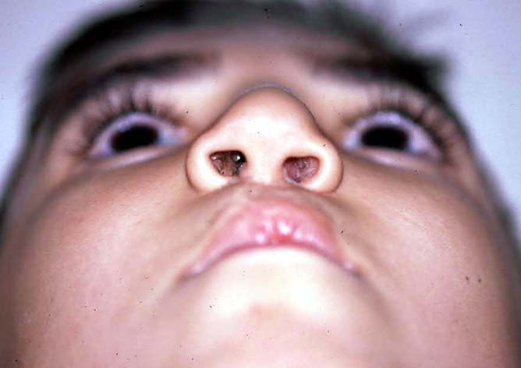

Slide 49
Cleft Palate

Slide 50
Cleft Palate
Palate and palatal muscles close the velopharengeal valve
Velopharengeal closure can not be done in cleft palate patient.
Patient can not create intraoral pressure
Feeding and speech are effected

Slide 51
Anatomy
Soft palate muscles insert on posterior margin of remaining hard palate rather than midline raphe

Slide 52
Cleft Palate
Affects 1/2500 living births
More often in girls
Heredity is less affects
Complete up to incisive foramen
İncomplete Only soft palate cleft

Slide 53
Problems with cleft palate
Feeding
Speech
Hearing and middle ear problems
Additional anomalies (% 30)
Psychological problems

Slide 54
Goal of Palatal Repair
Understandable speech
No maxillary retrusion
No hearing problem
Good occlusion

Slide 55
Submucous Cleft Palate
Anatomic problem
Muscles are not fused middle of palate (muscular diastasis)
notch at the back of the hard palate
Bifid uvula
Persistent ear disease
swallowing difficulties
Mostly asymptomatic
% 15 velopharengeal insufficiency
Short soft palate
Limited motion
Easy to get tired while speaking
When light goes through nose, light can be seen from oral side
It is not necessary surgical treatment until child growth enough to cooperate

Slide 56
Treatment of Submucous Cleft Palate
Submucous cleft palate only requires surgery if it is causing problems for the individual
The most common reason for treating a person with a submucous cleft palate is because of abnormal, nasal-sounding speech

Slide 57
Von laganbeck palatoplasty

Slide 58
VWK palatoplasty

Slide 59
Two flap palatoplasty

Slide 60
Pierre Robin Sequence
Micrognathy
Glossoptosis
Airway obstruction
Cleft palate( % 50 )
Breathing and feeding problem

Slide 61
Complications
Acute Period
bleeding,
Airway obstruction
Infection
Wound seperatiom
Late
maksillary hipoplasia, dental oklusion problems)
Hearing problems
velopharyngeal insufficency
Fistula formation

Slide 62
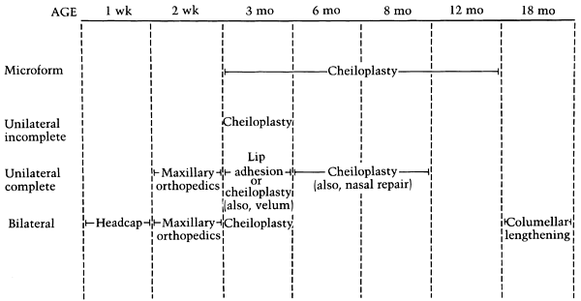
Cleft lip and palate treatment time table

Slide 63
Velopharyngeal Insufficency
The inability of the velopharyngeal sphincter to sufficiently separate the nasal cavity from the oral cavity during speech
Speech problem
(hypernasality, nasal emission, consanant production difficulty, decrese in voice strength and short phrases)
swallowing problems

Slide 64
Treatment of Velopharyngeal Insufficency
Patient should evaluate by speech terapist before any treatment
Nasendoscopic evaluation and Multiview videofluoroscopy is importany diagnostic tests
Goal is to provide normal velopharyngeal anatomy

Slide 65
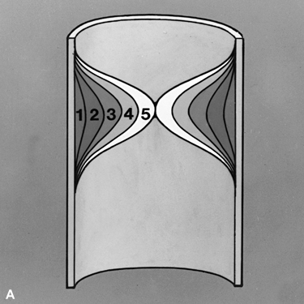
Pharyngeal wall motion. B: Markings for a proposed
tailor-made pharyngeal flap. The 2.5 cm width
is one half the width of the posterior pharynx5 and
would be appropriate for a patient whose
pharyngeal wall motion ranges from 3–3.5.
Pharyngeal wall motion. A: Frontal view of
the oropharynx showing gradations of
medial motion of the lateral pharyngeal
walls. 0 = no motion, 5 = maximal motion to the midline.

Slide 66
Surgical Treatment of Velopharyngeal Insufficency
Pharyngeal Flaps (Superior, inferior pedicled)
Pharyngoplasty (Hynes, Orticochea)
Soft palate lengtening and levator muscle repair
Posterior wall augmentation (teflon, proplast)

Slide 67
Other Operations
Fistula Repair
Velopharyngeal Insufficency correction (5 yeras)
Secondary Onarımlar (preschool age)
Alveolar bone grafting (before canine theth eruption)
Orthodontic Surgery (12-14 years)
(Le-Fort I Maksillary osteotomy, Mandibular split ramus osteotomy)
Rhinoplasty (16-18 years)

